Slide 1
Maze

Slide 2
Core Rules

Slide 3

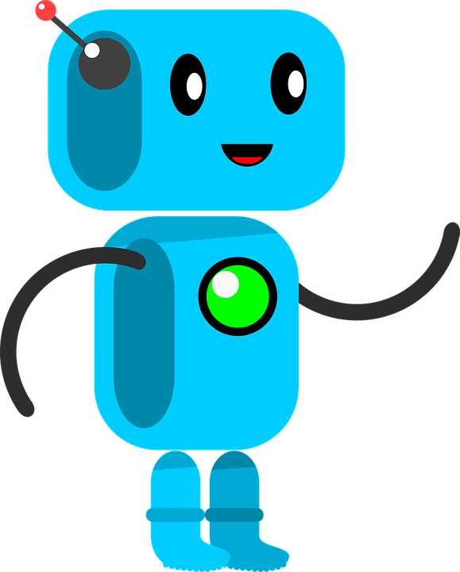
The Game
 |  |  | ⬤
 |  |  | ⬤
Agent: Robot
Actions: Take adjacent path
State: Maze, robot Position, Q-values
Rewards: Numbers written on pathways
Goal: reach battery reliably

Slide 4
The Game
 |  |  | ⬤
 |  |  | 3
 |  |  |  | 2
 |  |  | 4
Whenever the robot reaches a new intersection, it writes a random number (use dice) on each path
The robot then takes the path with the highest number

Slide 5
The Game
 |  |  | ⬤
 |  |  | 3
 |  |  | ⬤ | 2
 |  |  | 4
 |  |  | -1
Whenever the robot reaches a dead end, it writes -1

Slide 6
The Game
 |  |  | ⬤
 |  |  | 3
 |  |  | ⬤ | 2
 |  |  | -2
 |  |  | -1
Whenever the robot reaches a dead end, it writes -1
Then the robot updates the number of the path where it came from to the new highest value (-1) minus one (-1-1=-2)

Slide 7
The Game
 |  |  | ⬤
 |  |  | 3
 |  |  |  | 2
 |  |  | -2
 |  |  | -1
In case of a dead end, the robot then returns to the previous crossing and continues by choosing the highest number

Slide 8
The Game
 |  |  | 6
 |  | 4 |  | 6
 |  |  | 1
 |  |  | 3
 |  |  | ⬤ | 2
 |  |  | -2
 |  |  | -1
New crossing -> random numbers

Slide 9
The Game
 |  |  | 6
 |  | 4 |  | 6
 |  |  | 1
 |  |  | 5
 |  |  | ⬤ | 2
 |  |  | -2
 |  |  | -1
New crossing -> random numbers
Update pathway to new highest (6) minus one (6-1=5)

Slide 10
The Game
 |  |  | 6
 |  | 4 |  | 6
 |  |  | 1
 |  |  | 5
 |  |  | ⬤ | 2
 |  |  | -2
 |  |  | -1
New crossing -> random numbers
Update pathway to new highest (6) minus one (6-1=5)
If there are two or more biggest numbers, the robot choses a random one (in this case: up)

Slide 11
The Game
 |  |  | -1
 |  |  | 6
 |  | 4 | ⬤ | 6
 |  |  | 1
 |  |  | 5
 |  |  | ⬤ | 2
 |  |  | -2
 |  |  | -1
The robot continues until it reaches it’s goal

Slide 12
The Game
 |  |  | -1
 |  |  | -2
 |  | 4 | ⬤ | 6
 |  |  | 1
 |  |  | 5
 |  |  | ⬤ | 2
 |  |  | -2
 |  |  | -1
The robot continues until it reaches it’s goal

Slide 13
The Game
 |  |  | -1
 |  |  | -2
 |  | 4 |  | 6
 |  |  | 1
 |  |  | 5
 |  |  | ⬤ | 2
 |  |  | -2
 |  |  | -1
The robot continues until it reaches it’s goal

Slide 14
The Game
 |  |  | -1
 |  |  | -2
 |  | 4 | ⬤ | 6 |  |  |  |  |  | 100
 |  |  | 1
 |  |  | 5
 |  |  | ⬤ | 2
 |  |  | -2
 |  |  | -1
The goal in this maze has a value of 100

Slide 15
The Game
 |  |  | -1
 |  |  | -2
 |  | 4 | ⬤ | 99 |  |  |  |  |  | 100
 |  |  | 1
 |  |  | 5
 |  |  | ⬤ | 2
 |  |  | -2
 |  |  | -1
The goal in this maze has a value of 100
Don’t forget to update the path!

Slide 16
The Game
 |  |  | -1
 |  |  | -2
 |  | 4 | ⬤ | 99 |  |  |  |  |  | 100
 |  |  | 1
 |  |  | 5
 |  |  | ⬤ | 2
 |  |  | -2
 |  |  | -1
The goal in this maze has a value of 100
Don’t forget to update the path!
Then the robot returns to the first room and starts another round

Slide 17
The Game
 |  |  | -1
 |  |  | -2
 |  | 4 | ⬤ | 99 |  |  |  |  |  | 100
 |  |  | 1
 |  |  | 5
 |  |  | ⬤ | 2
 |  |  | -2
 |  |  | -1
Continue until the robot doesn’t learn anything new (write or correct numbers)

Slide 18
The Game
 |  |  | -1
 |  |  | -2
 |  | 4 | ⬤ | 99 |  |  |  |  |  | 100
 |  |  | 1
 |  |  | 99
 |  |  | ⬤ | 2
 |  |  | -2
 |  |  | -1
Finally, the robot has learned a reliable path to its goal

Slide 19
Exploration vs Exploitation

Slide 20
The Problem
Some actions can have an immediate positive effect but a long term negative effect

Slide 21
The Problem
Some actions can have an immediate positive effect but a long term negative effect
E.g. the robot takes a path and continues walking, but many steps later it turns out to be a dead end.

Slide 22
The Problem
Some actions can have an immediate positive effect but a long term negative effect
E.g. the robot takes a path and continues walking, but many steps later it turns out to be a dead end.
Some actions might only have a small immediate positive effect but a big long term positive effect

Slide 23
The Problem
Some actions can have an immediate positive effect but a long term negative effect
E.g. the robot takes a path and continues walking, but many steps later it turns out to be a dead end.
Some actions might only have a small immediate positive effect but a big long term positive effect
E.g. the robot finds a rewarding battery, but there would be an even more rewarding one along the next path

Slide 24
The Solution
Find a balance between exploiting already learned information and exploring new possibilities

Slide 25
The Solution
Find a balance between exploiting already learned information and exploring new possibilities
E.g. instead of always choosing the path with the highest number, the robot could have a 25% chance of taking a random path

Slide 26
The Solution
Find a balance between exploiting already learned information and exploring new possibilities
E.g. instead of always choosing the path with the highest number, the robot could have a 25% chance of taking a random path
This exploration rate can also be dynamic, so that it is high in the beginning but gets lower as the robot improves its understanding of the environment

